Slide 1

Exploratory Data Analysis On AMCAT
Presented By – Sneha Chandurkar

Slide 2
About me
Background : I've always been a proactive learner, a completed MBA(HR), and prepared to contribute to organizational success while developing new skills and gaining real-world experience. I am highly responsible and organized with excellent writing, communication, and critical thinking abilities. I am excited to learn data science because it is an ideal way to combine my love of technology and my passion for solving problems. There is a tone of information generated every second in today's data-driven society, and I'm enthusiastic about the possibility of gaining insightful knowledge from this data to inform choices and address practical problems. I have worked on many individual and team projects in different domains, full stack being the primary focus and have developed my coding skills. I am also familiar with a few popular programming languages like SQL, Python Excel, Tableau, ML etc. I'm looking forward to connecting with outstanding people in the industry to work with them and explore more!!
Why you want to learn Data Science : Without data science, companies of all sizes, espically large organizations, would have difficulty making informed decision.
Any work experience : I am a Data Science Intern at Innomatics Research Labs.
Share your linkedin : www.linkedin.com/in/sneha-dahat
Github profile urls : https://github.com/SnehaDahat

Slide 3
Agenda (This should be the PPT flow)
Business Problem and Use case domain understanding(If Required)
Objective of the Project
Web Scraping – Details (Websites, Processor you followed)
Summary of the Data
Exploratory Data Analysis:
Data Cleaning Steps
Data Manipulation Steps
Univariate Analysis Steps
Bivariate Analysis Steps
Key Business Question
Conclusion (Key finding overall)
Q&A Slide
Your Experience/Challenges working on Web Scraping – Data Analysis Project.

Slide 4
Objective :
The dataset was released by Aspiring Minds from the Aspiring Mind Employment Outcome 2015 (AMEO). The study is primarily limited only to students with engineering disciplines. The dataset contains the employment outcomes of engineering graduates as dependent variables (Salary, Job Titles, and Job Locations) along with the standardized scores from three different areas – cognitive skills, technical skills and personality skills. The dataset also contains demographic features. The dataset contains around 40 independent variables and 4000 data points. The independent variables are both continuous and categorical in nature. The dataset contains a unique identifier for each candidate. Below mentioned table contains the details for the original dataset.

Slide 5
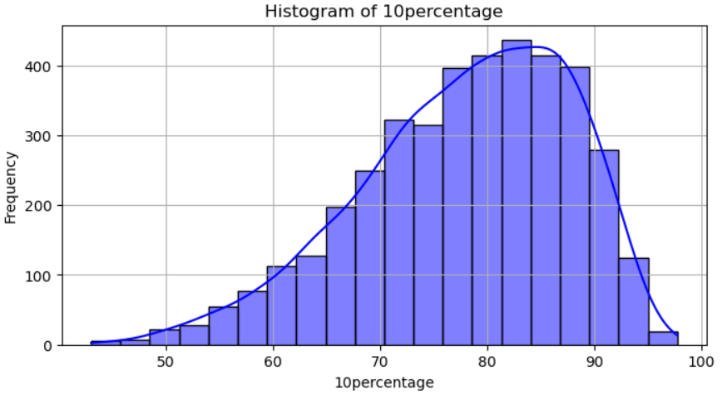
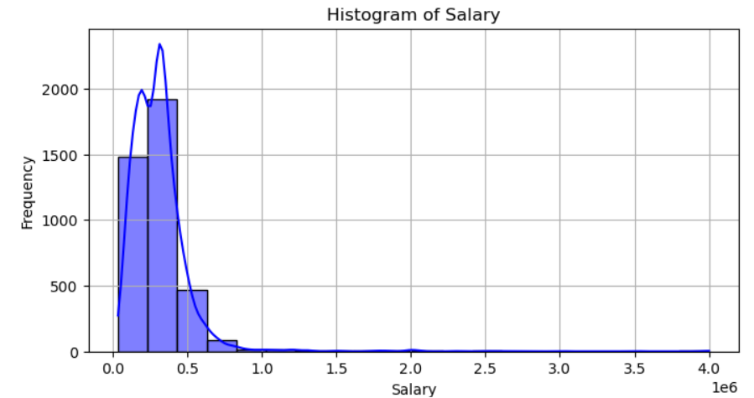
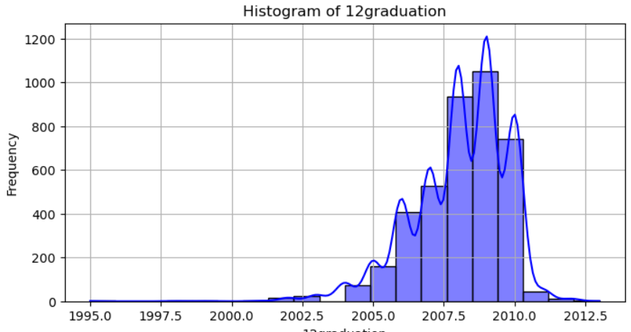
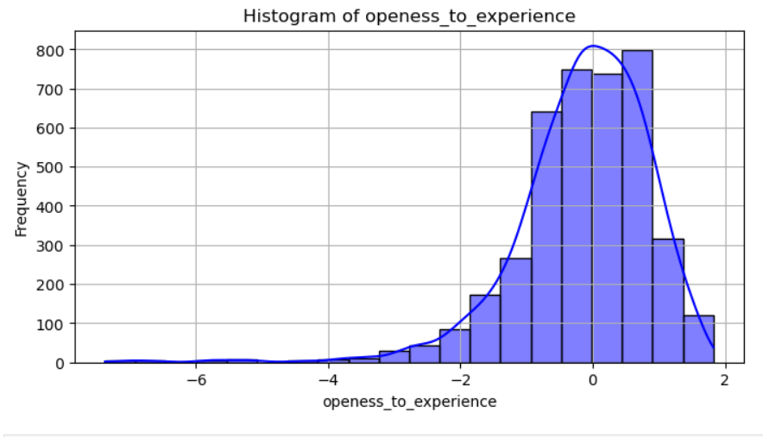
Univariate Analysis

Slide 6
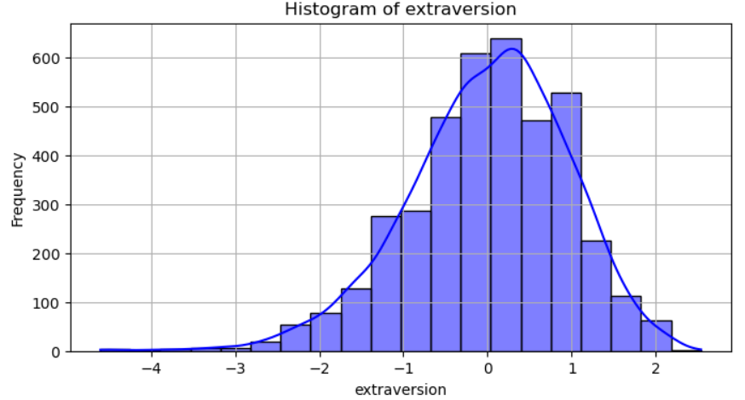
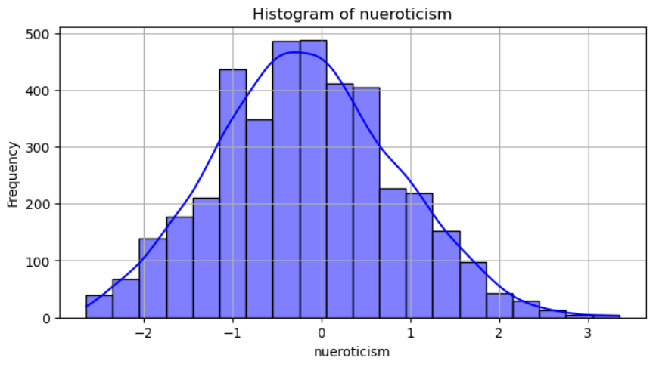
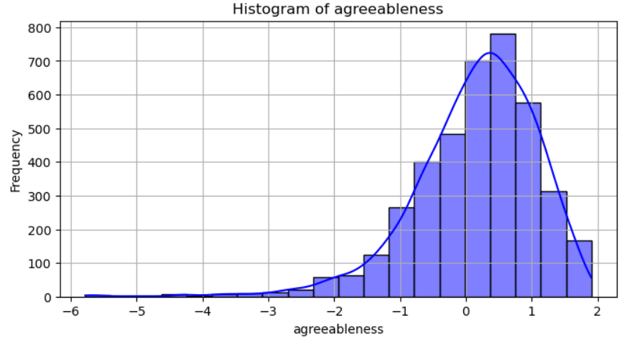
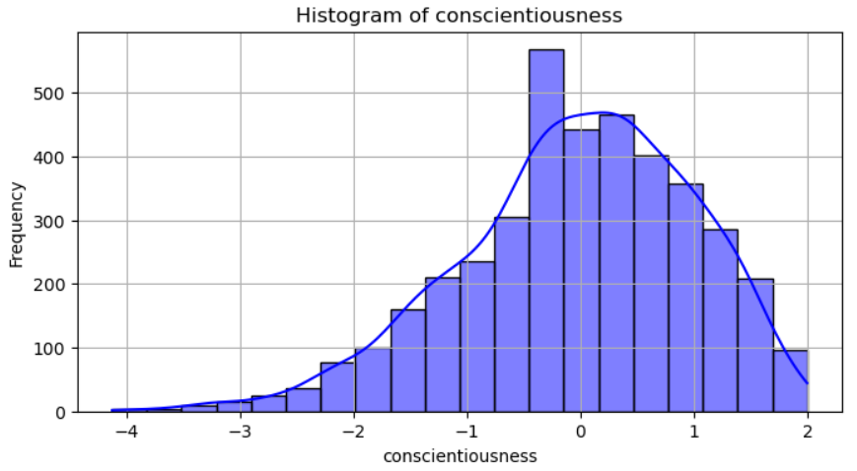

Slide 7
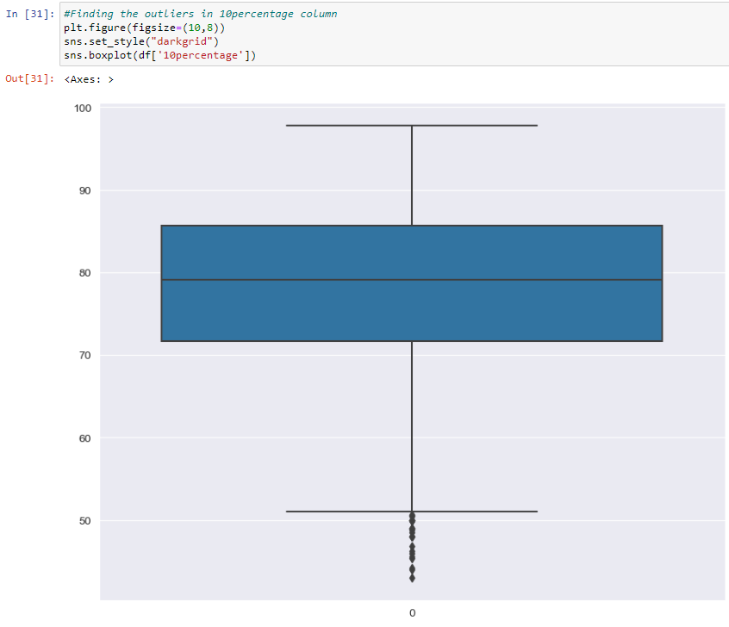
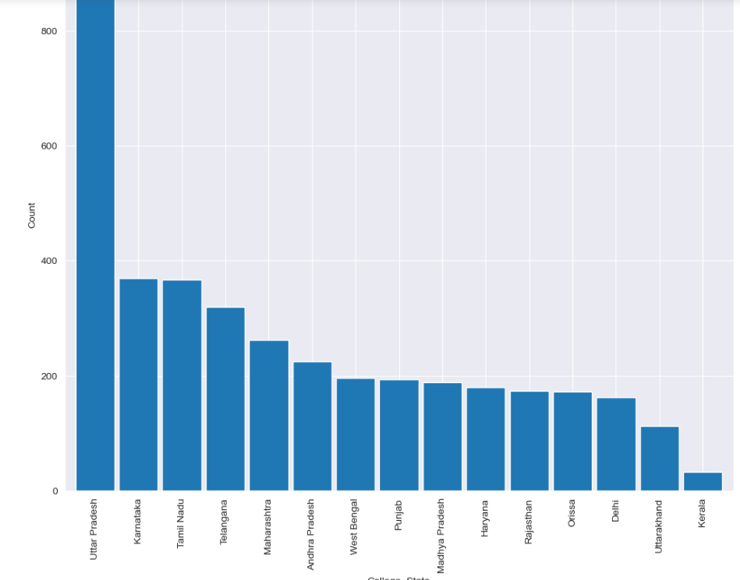
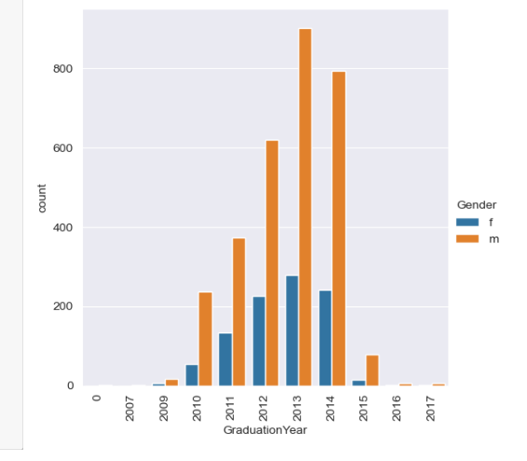
Bivariate Analysis :

Slide 8
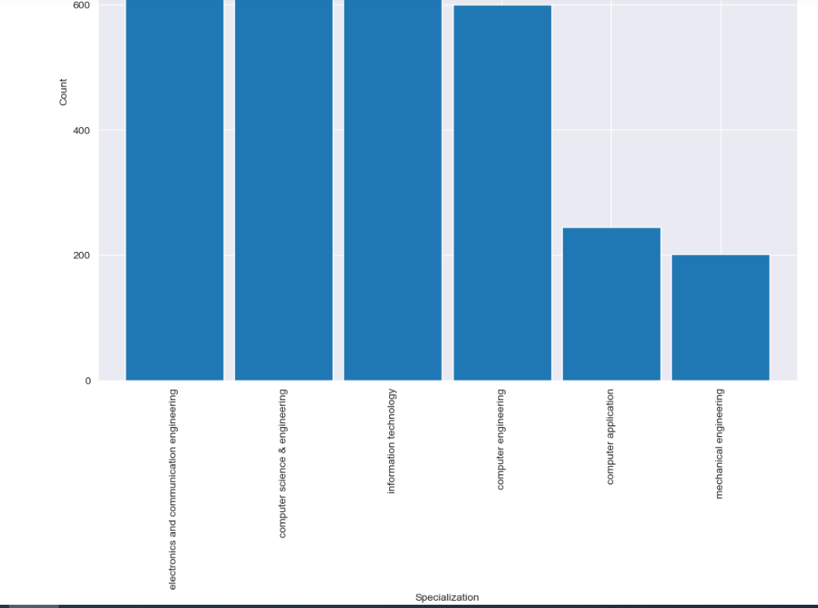

Slide 9
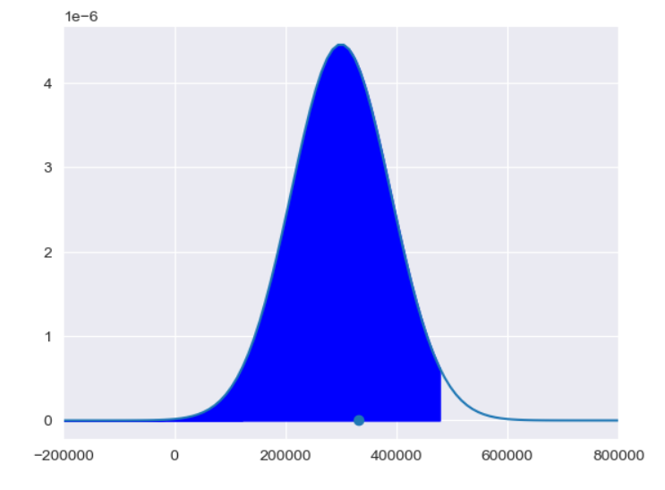
Research Questions
Times of India article dated Jan 18, 2019 states that “After doing your Computer Science Engineering if you take up jobs as a Programming Analyst, Software Engineer, Hardware Engineer and Associate Engineer you can earn up to 2.5-3 lakhs as a fresh graduate.” Test this claim with the data given to you. Is there a relationship between gender and specialization?
Research Questions:

Slide 10
Conclusion:
The primary objective of this analysis was to evaluate the employment prospects of graduates based on their AMCAT scores and identify key factors influencing their job placements. The analysis revealed that candidates with higher AMCAT scores in technical domains were significantly more likely to secure positions in software engineering and related fields. Additionally, graduates specializing in software engineering had a median starting salary of approximately 3 lakhs, aligning with industry expectations.

Slide 11

THANK YOU

